Slide 1
Automated Vehicle Interaction with Pedestrians
PIs:
Lionel P. Robert Jr. (School of Information, UM-Ann Arbor)
Dawn M. Tilbury (Mechanical Engineering, UM-Ann Arbor)
Xi (Jessie) Yang (Industrial and Operations Engineering, UM-Ann Arbor)
Anuj K. Pradhan (Mechanical and Industrial Engineering, Umass-Amherst)
Student: Suresh Kumaar Jayaraman (Mechanical Engineering, UM-Ann Arbor)

Slide 2
Motivation
Crossing Behavior
Long-term predictions
Multiple future prediction (multi-modal)
Computational efficiency
Explainability

Slide 3
Related Work
Physics-based
Planning-based
Pattern-based
Neural Networks
Deep learning

Slide 4
Research Questions
How is pedestrian crossing behavior influenced by the implicit driving behavior of the AVs?
How best to represent pedestrian behavior suited for AV planning applications?
How does interaction between multiple agents influence the predictions?

Slide 5
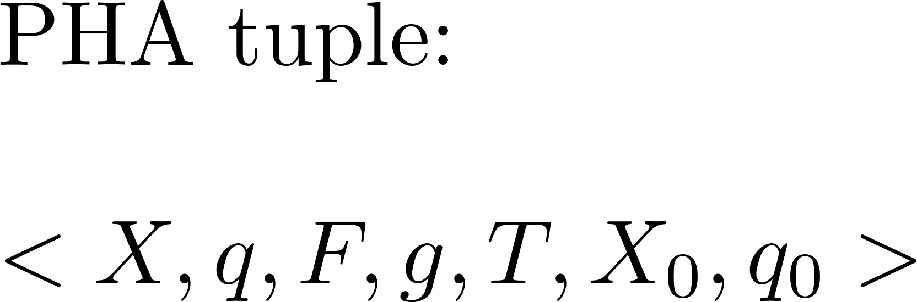
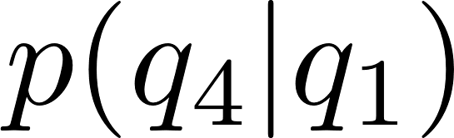
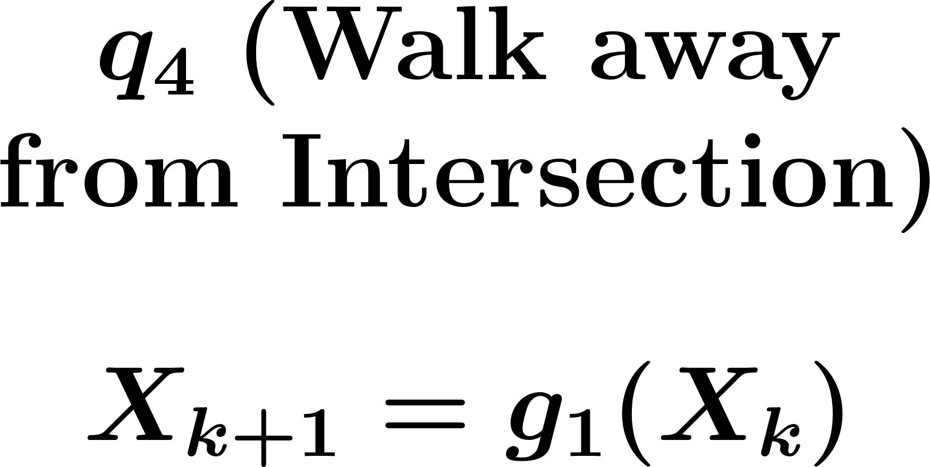
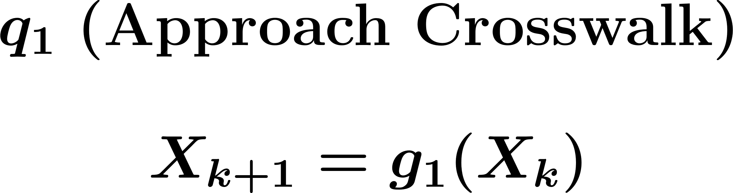
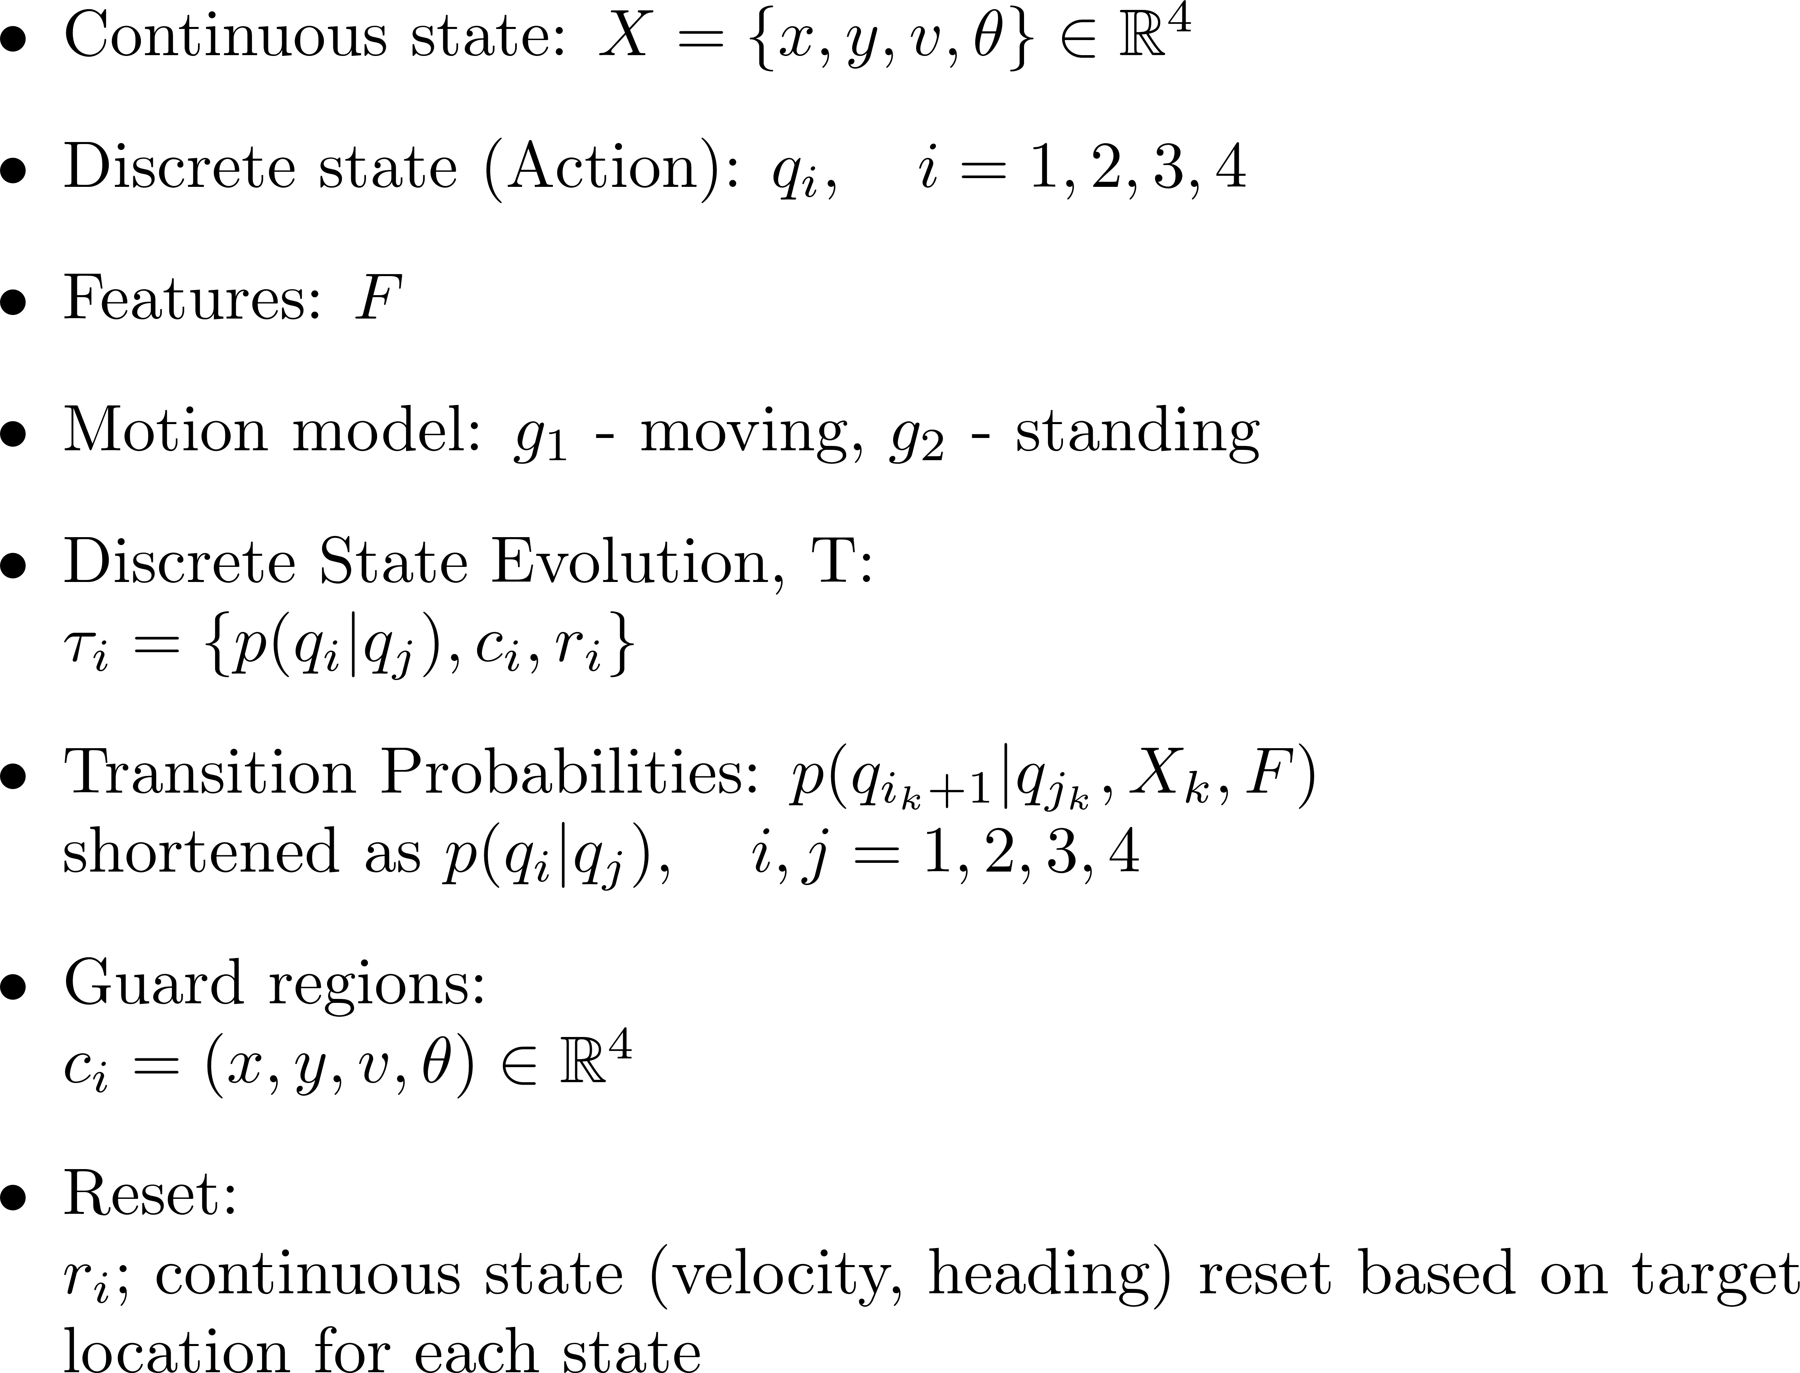
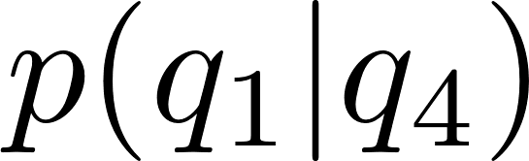

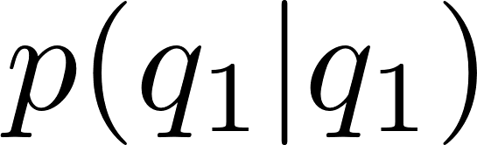
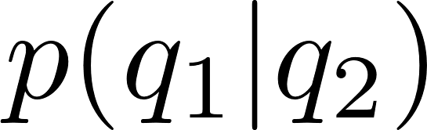
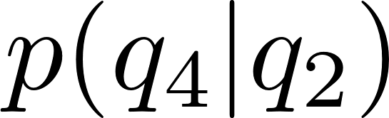
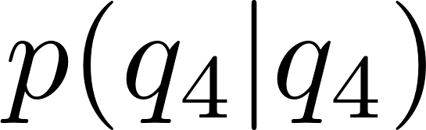
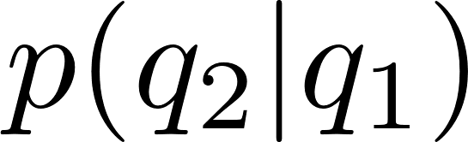
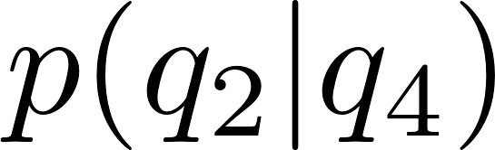
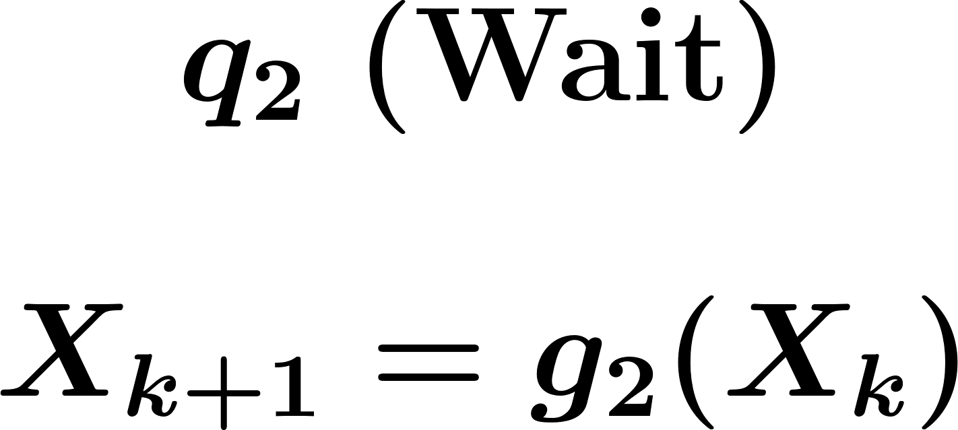
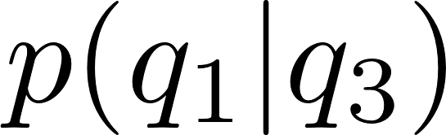
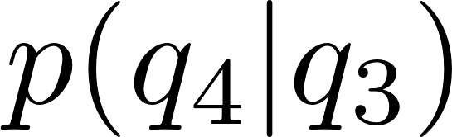
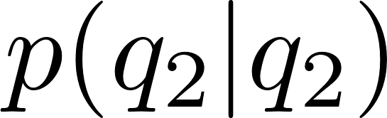
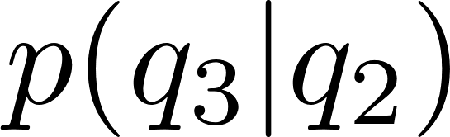
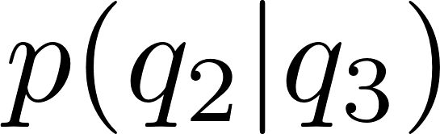
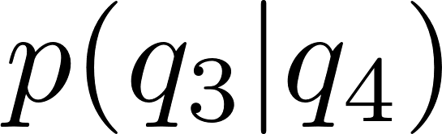
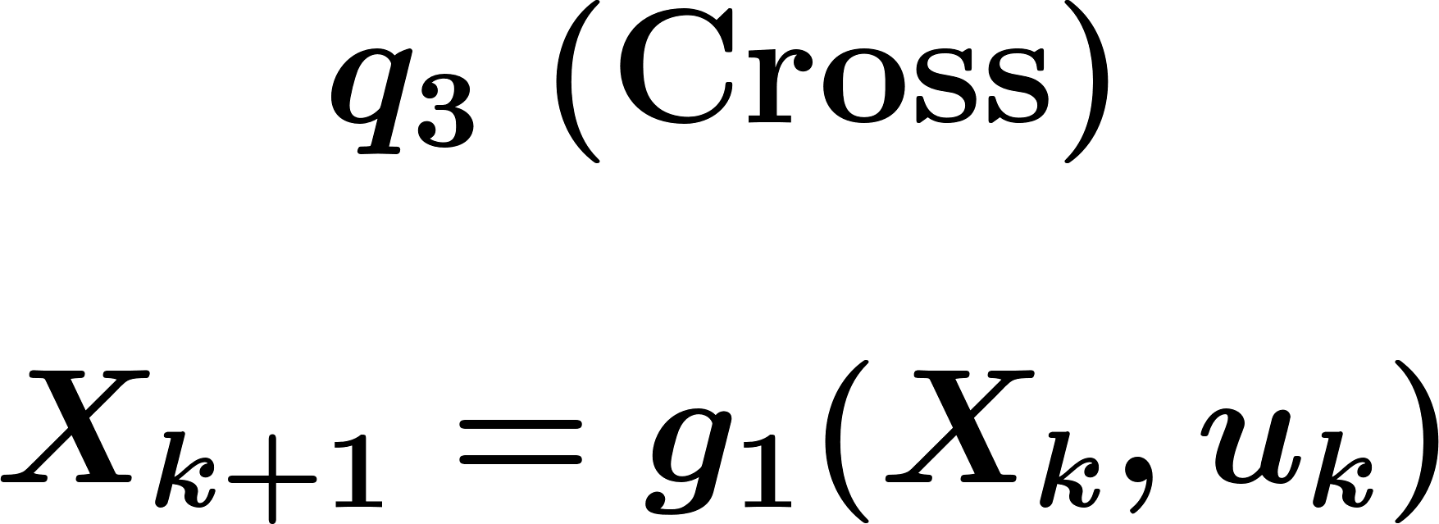
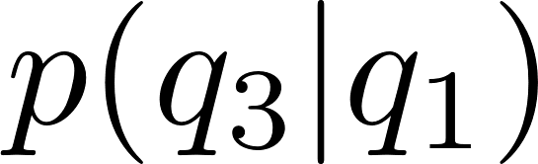

Hybrid Framework – Probabilistic Hybrid Automata
Notes:
For capturing both long-term and short-term pedestrian dynamics, I am proposing a hybrid framework where each possible pedestrian action is a discrete state with probabilistic transition between the states.

Slide 6
Hybrid Framework – Current Focus
Define continuous dynamics model
Discrete state probabilistic classification model
Summary Stats
Logistic Regression
Gap acceptance Probability distribution
Time Series
ARMA
Neural Network
RNN - LSTM
Notes:
For capturing both long-term and short-term pedestrian dynamics, I am proposing a hybrid framework where each possible pedestrian action is a discrete state with probabilistic transition between the states.

Slide 7
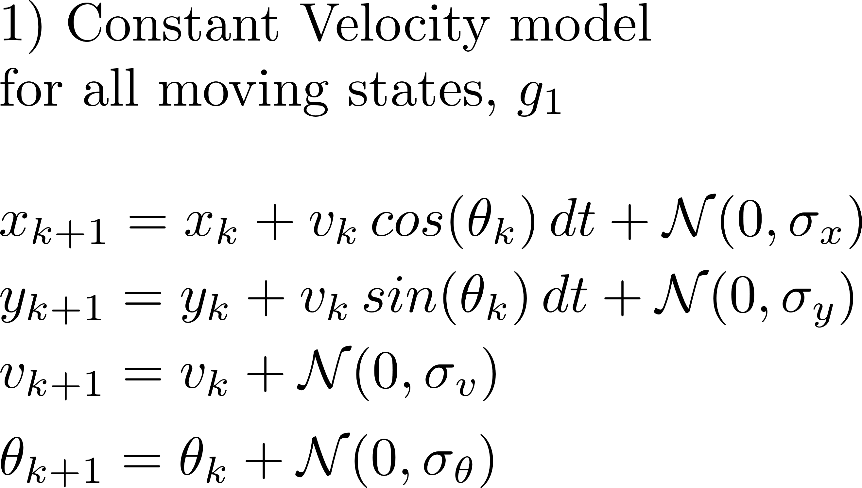
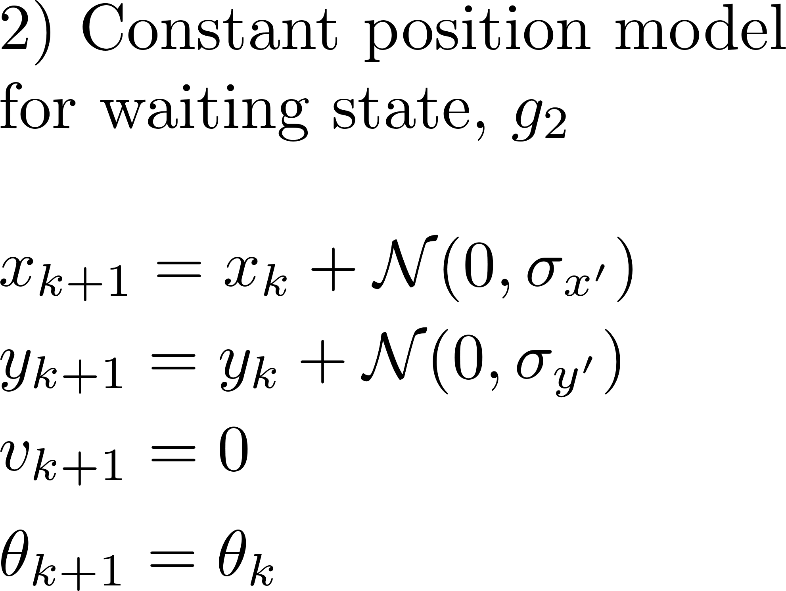


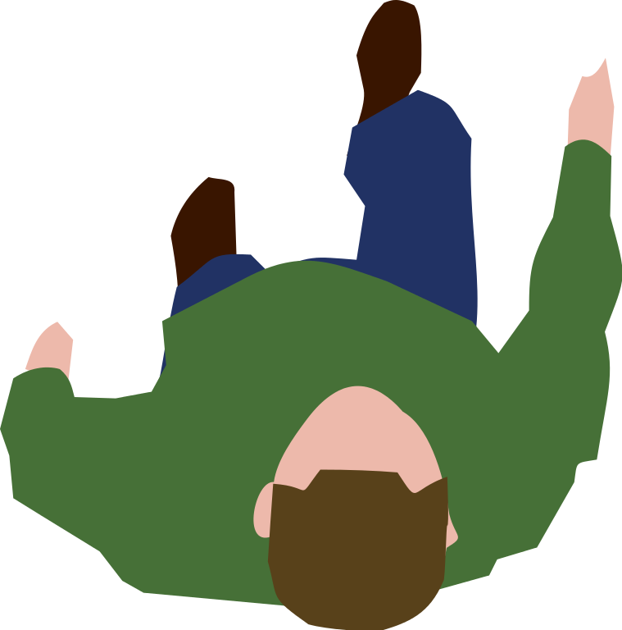


Proposed model – short term dynamics with Noise
Assumption: Pedestrian velocity remains constant when walking
Assumption: Gaussian Noise for continuous states
Notes:
The steps for hybrid model includes defining the motion models within each of the discrete state and defining the model to calculate the discrete state transitions.
Consider a constant velocity model for each of the three moving states – approach, cross, and walkaway and a constant position model for the wait state.
Each discrete state is assumed to have fixed target that is obtained from the map of the environment and the velocity and heading are fixed based on initial observations and target and updated based on measurements.

Slide 8
Proposed model – short term dynamics with Noise
Change the dynamics – Cartesian velocity
Assumption: Pedestrian velocity remains constant when walking
Assumption: Gaussian Noise for continuous states
Notes:
The steps for hybrid model includes defining the motion models within each of the discrete state and defining the model to calculate the discrete state transitions.
Consider a constant velocity model for each of the three moving states – approach, cross, and walkaway and a constant position model for the wait state.
Each discrete state is assumed to have fixed target that is obtained from the map of the environment and the velocity and heading are fixed based on initial observations and target and updated based on measurements.

Slide 9
Proposed prediction model – long term dynamics
Discrete State transitions (long-term behavior)
Inputs
Output
History of discrete states, continuous states and features
Sequence of probabilities of discrete states
Mean of observations
Probabilistic Classifier
Features would include vehicle dynamics, interaction parameters, traffic characteristics and pedestrian dynamics
Notes:
For predicting the long-term dynamics, I am using the state of the art Recurrent Neural Network framework called Long Short Term Memory. The model is capable of using time-series inputs to learn temporal relationship between the inputs and give accurate predictions. Since crossing is a time-dependent activity, this model is suitable for predicting crossing trajectories.
Possible inputs include the history of pedestrian dynamics, the vehicle dynamics, traffic characteristics and other interaction cues. The model output the transition probability of the discrete states

Slide 10
Proposed prediction model – long term dynamics
Discrete State transitions (long-term behavior)
Inputs
Output
Discrete states, continuous states and features at instances when gap is evaluated
Sequence of probabilities of discrete states
Probabilistic Classifier
Features would include vehicle dynamics, interaction parameters, traffic characteristics and pedestrian dynamics
Notes:
For predicting the long-term dynamics, I am using the state of the art Recurrent Neural Network framework called Long Short Term Memory. The model is capable of using time-series inputs to learn temporal relationship between the inputs and give accurate predictions. Since crossing is a time-dependent activity, this model is suitable for predicting crossing trajectories.
Possible inputs include the history of pedestrian dynamics, the vehicle dynamics, traffic characteristics and other interaction cues. The model output the transition probability of the discrete states

Slide 11
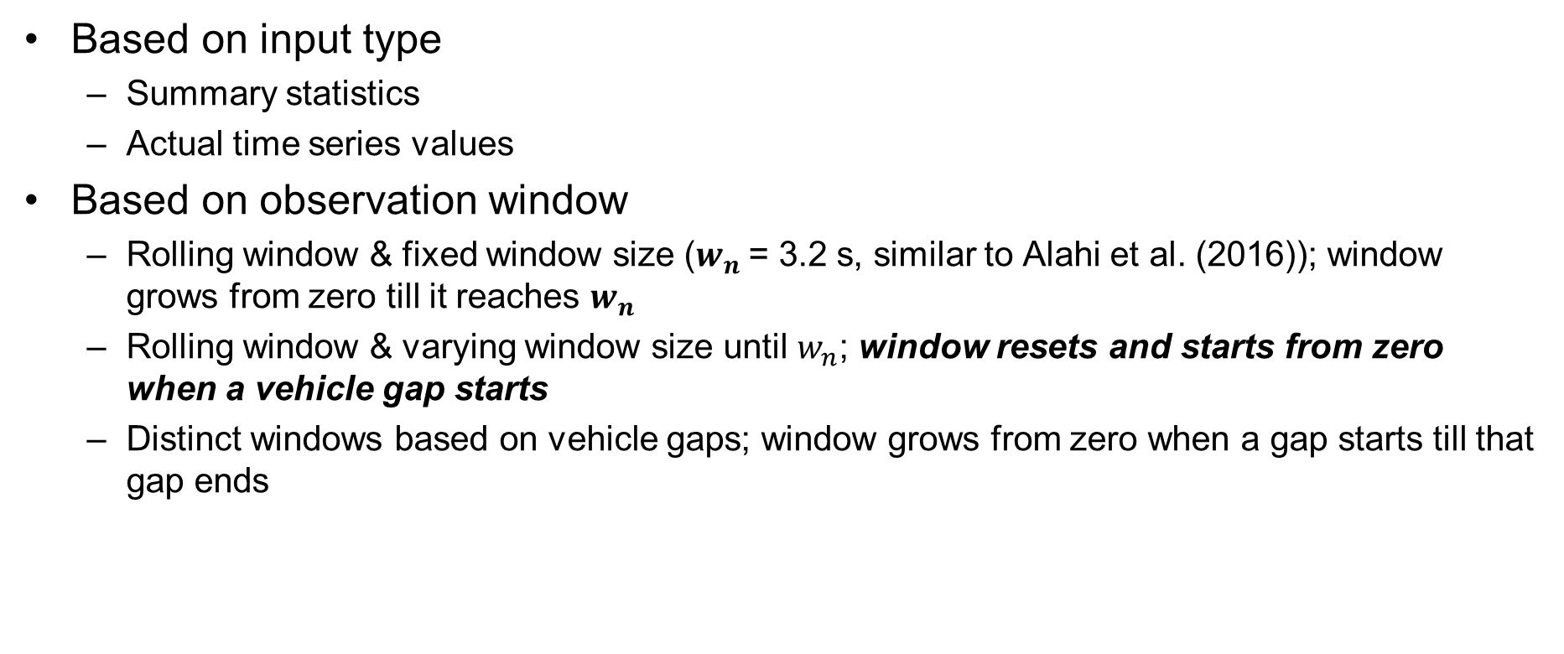
Classifier variants
Based on input type
Summary statistics
Actual time series values
Based on observation window
Rolling window & fixed window size ($w_{n}$= 3.2 s, similar to Alahi et al. (2016)); window grows from zero till it reaches $w_{n}$
Rolling window & varying window size until $w_{n}$; window resets and starts from zero when a vehicle gap starts
Distinct windows based on vehicle gaps; window grows from zero when a gap starts till that gap ends

Slide 12
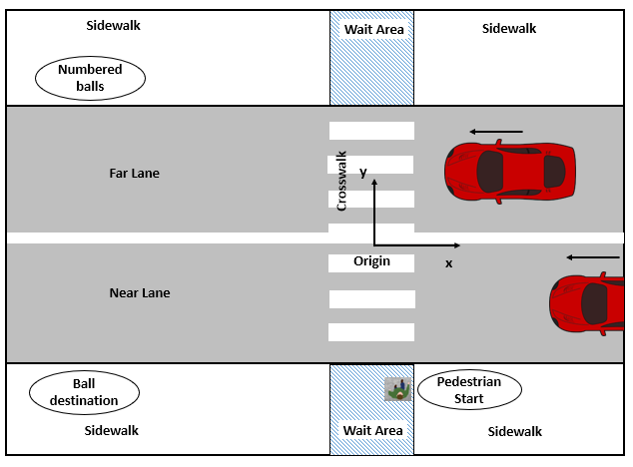
Pedestrian Features/Observations
Features | Description | Type
Pedestrian Position [m] |  | Continuous
Pedestrian Speed [m/s] |  | Continuous
Pedestrian distance to curb [m] | This refers to the y-distance between pedestrian and edge of sidewalk | Continuous
Pedestrian distance to crosswalk [m] | Distance between pedestrian position and closest | Continuous
Cumulative Waiting time [s] | Time elapsed from start of waiting | Continuous
Gaze at Vehicle | Proportion of time looking a | Categorical – Yes/No
Approach Direction | Same direction as the AV or opposite direction | Categorical – Same/Opposite
Pedestrian-Vehicle distance [m] | These two together, give the time gap
Vehicle instantaneous speed [m/s]

Slide 13
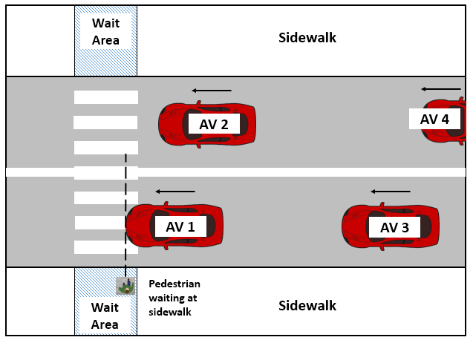
Vehicle Features/Observations
All four vehicles
Close and next in both lanes
Features | Description | Type
Vehicle Position [m] |  | Continuous
Vehicle Speed [m/s] |  | Continuous
Vehicle Acceleration [m/s2] |  | Continuous
Distance between vehicles in same lane [m] |  | Continuous
Interaction Features
Features | Description | Type
Vehicle to pedestrian distance [m] |  | Continuous
Time to Collision [s] | Veh-ped distance/instantaneous vehicle speed | Continuous

Slide 14
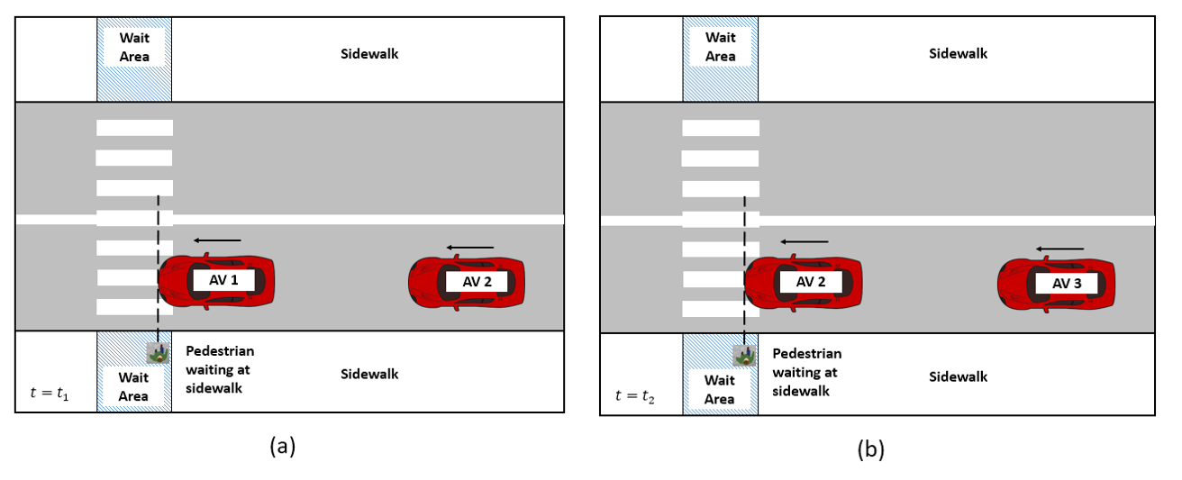
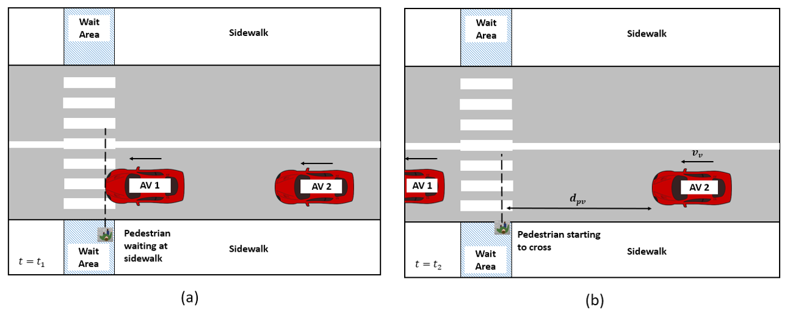
Summary Statistics of entire observation interval
Features | Description | Type
Gaze Ratio | Proportion of time looking at vehicle | Continuous
Gap duration [s] |  | Continuous
Wait gap duration: t2-t1
Cross gap duration: (t2-t1) + (dpv/vv)

Slide 15
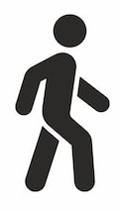

Interval Format - 1
Intervals splits based on vehicle gaps for calculating the other observations
Considers interaction with each vehicle separately
Vehicle ‘k’ crosses pedestrian
Vehicle ‘k+1’ crosses pedestrian
Vehicle ‘k+2’ crosses pedestrian
Vehicle ‘k+3’ crosses pedestrian
Vehicle ‘k+N’ crosses pedestrian
Approach starts after picking up ball/drop ball and returning
Wait starts when v~=0
Starts to cross
Events timeline
Wait gap
Wait gap
Wait gap
Cross gap
Approach action
Wait Action

Slide 16
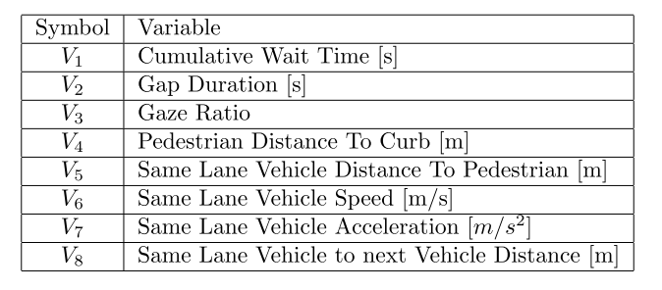
Input for training the Cross from Wait decision logistic regression models
Initial plan: Mean of parameters of the gap interval
Easy to train; more discriminative power

Slide 17
Results – Cross from Wait decision
Features | Accuracy of identifying cross/wait gaps
All features | 94%
Gap duration, veh-ped distance, veh speed, veh acc, veh-veh distance | 94%
Minimal set - Gap duration, veh-ped distance, veh speed, veh acc, | 93%
Real time evaluation
Mean of parameters from cumulative observation window that resets after each gap
Accuracy (1 subject data) – 61%
Class discrimination mainly based on vehicle parameters
Similar vehicle parameters for wait/cross classes at the start of the gap; but model learned to discriminate for entire gap observations
Conclusion
Real time evaluation with model trained on mean of entire gap not accurate

Slide 18
Approaches in Literature
Gap acceptance (Logistic Regression)
Model trained on age, gender, waiting time, vehicle speed at start of gap, pedestrian-vehicle distance at start of gap, expected gap (or time-to-collision) at start of gap
Probability of acceptance/reject evaluated at the start of the gap
Sun et al. (2002), Fitzpatrick et al. (2006)
Action classification (Neural Networks, SVM, etc.) – Approach 1
Concatenated time series data (fixed time steps, around 1 s) for both training and evaluation
Action labels based on final output of that time series data (Cross/Wait)
Volz et al. (2016), Fang et al. (2018)

Slide 19
Currently trying: Interval Format - 2
Intervals splits based on vehicle gaps
Sliding window within each gap
Final label of that gap given to each sliding window observation within that gap
Considers interaction with each vehicle separately
Vehicle ‘k’ crosses pedestrian
Vehicle ‘k+1’ crosses pedestrian
Vehicle ‘k+2’ crosses pedestrian
Vehicle ‘k+3’ crosses pedestrian
Vehicle ‘k+N’ crosses pedestrian
Approach starts after picking up ball/drop ball and returning
Wait starts when v~=0
Starts to cross
Events timeline
Wait gap
Wait gap
Wait gap
Cross gap
Approach action
Wait Action

Slide 20
Currently trying: Interval Format - 3
Fixed observation history
1 s (0.1 s sample time)
3.2 s (0.4 s sample time, similar to Alahi et al. (2016))

Slide 21
Currently trying: Data format
Actual time series observations
Mean of time series observations

Slide 22
References
Alahi, A., Goel, K., Ramanathan, V., Robicquet, A., Fei-Fei, L., & Savarese, S. (2016). Social LSTM: Human Trajectory Prediction in Crowded Spaces. In Proceedings of the IEEE conference on computer vision and pattern recognition (pp. 961–971).
Fang, Z., & López, A. M. (2018, June). Is the pedestrian going to cross? answering by 2d pose estimation. In 2018 IEEE Intelligent Vehicles Symposium (IV) (pp. 1271-1276). IEEE.
Völz, B., Behrendt, K., Mielenz, H., Gilitschenski, I., Siegwart, R., & Nieto, J. (2016, November). A data-driven approach for pedestrian intention estimation. In 2016 IEEE 19th International Conference on Intelligent Transportation Systems (ITSC) (pp. 2607-2612). IEEE.
Brewer, M., Fitzpatrick, K., Whitacre, J., & Lord, D. (2007). Exploration of Pedestrian Gap-Acceptance Behavior at Selected Locations. Transportation Research Record: Journal of the Transportation Research Board, 1982, 132–140. https://doi.org/10.3141/1982-18
Yannis, G., Papadimitriou, E., & Theofilatos, A. (2013). Pedestrian gap acceptance for mid-block street crossing. Transportation Planning and Technology, 36(5), 450–462. https://doi.org/10.1080/03081060.2013.818274
Sun, D., Ukkusuri, S. V, & Benekohal, R. F. (2002). Modeling of motorist-pedestrian interaction at uncontrolled mid-block crosswalks. Transportation Research Record, Urbana, 51(November 2002), 61801.

Slide 23
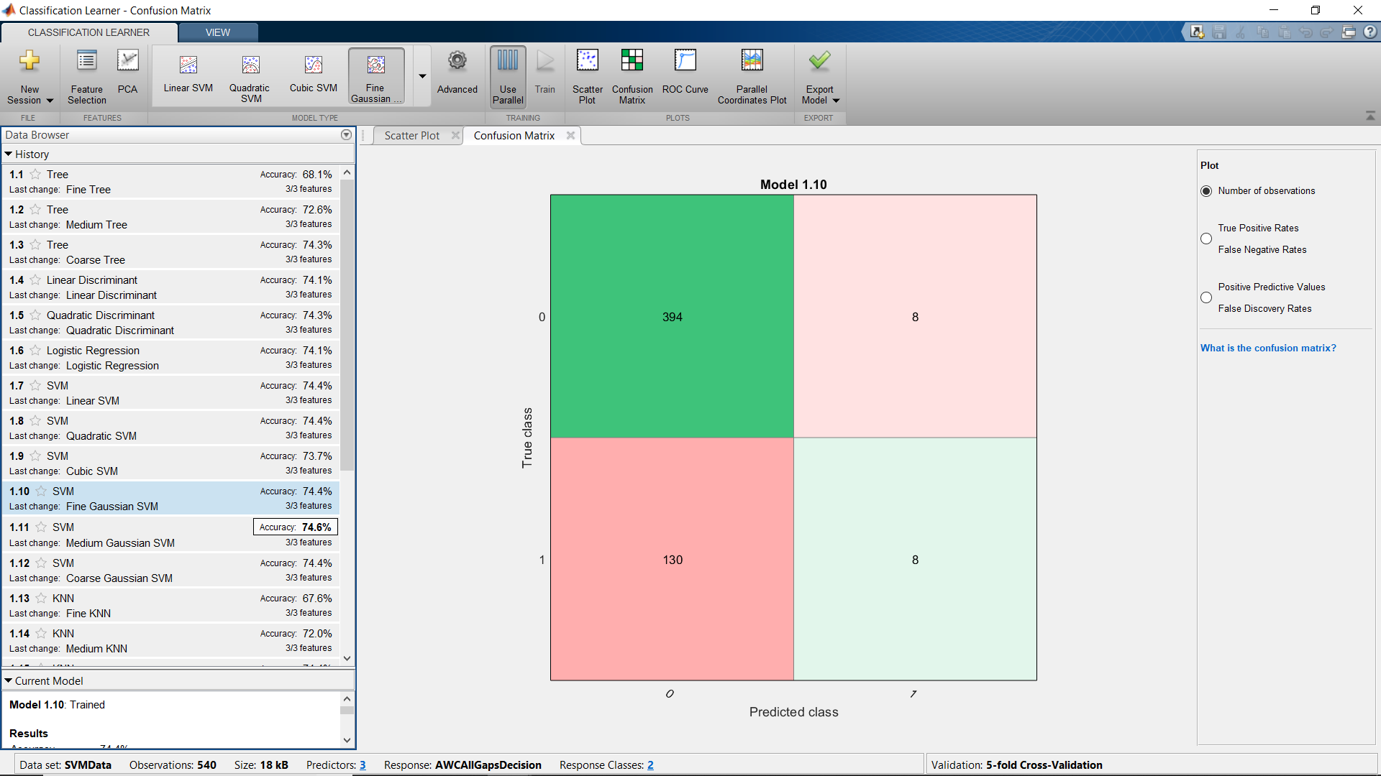
Results - Approach to Cross/Wait classifier
Evaluated at 1.5 m from crosswalk
Gaze ratio for last 1s
SVM with Fine Gaussian gives better F1 Score

Slide 24
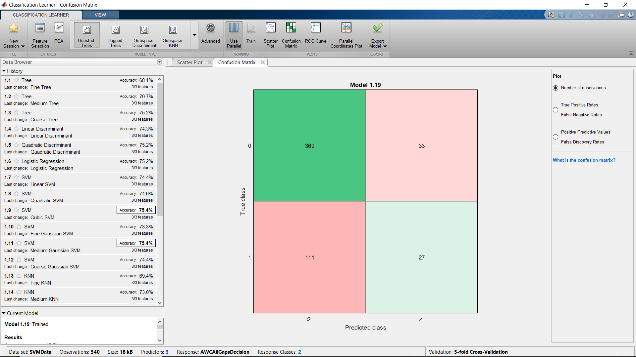
Results - Approach to Cross/Wait classifier
KNN better F1 Score
Evaluated at 1.0 m from crosswalk
Gaze ratio for last 1s

Slide 25
Results – Pedestrian Behavior
Waiting time

Slide 26
Results – Pedestrian Behavior
Waiting time outliers

Slide 27
Results – Pedestrian Behavior
Crossing speed

Slide 28
Results – Pedestrian Behavior
Gap acceptance

Slide 29
Results – Pedestrian Behavior (Learning)
Crossing speed over time

Slide 30
Results – Pedestrian Behavior (Learning)
Waiting time over time

Slide 31
Results – Pedestrian Behavior (Learning)
Gap acceptance over time

Slide 32
Results - Transition
sc

Slide 33
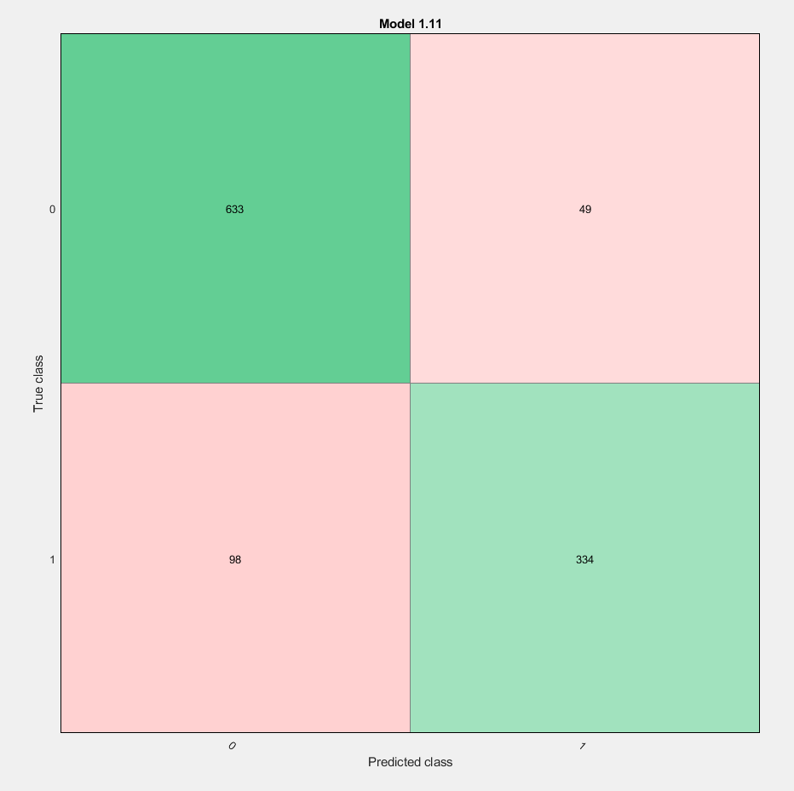
SVM
All 9 features

Slide 34
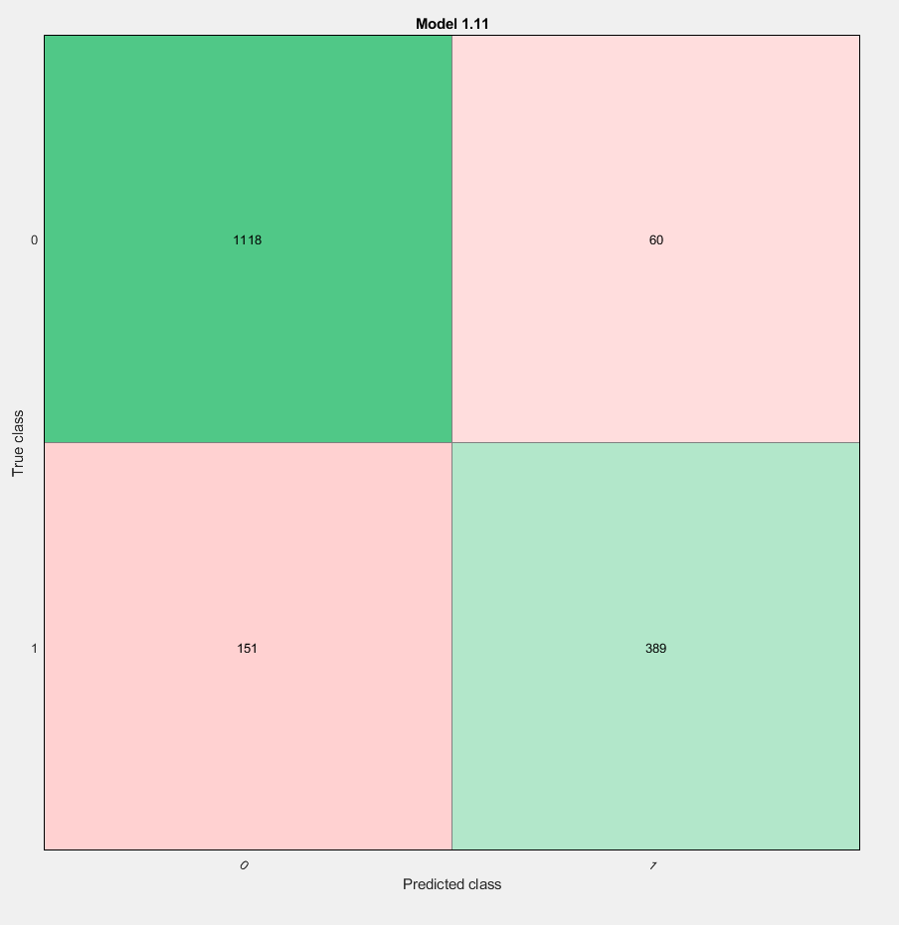
SVM – Medium Gaussian
All 9 features
UnNormalized

Slide 35
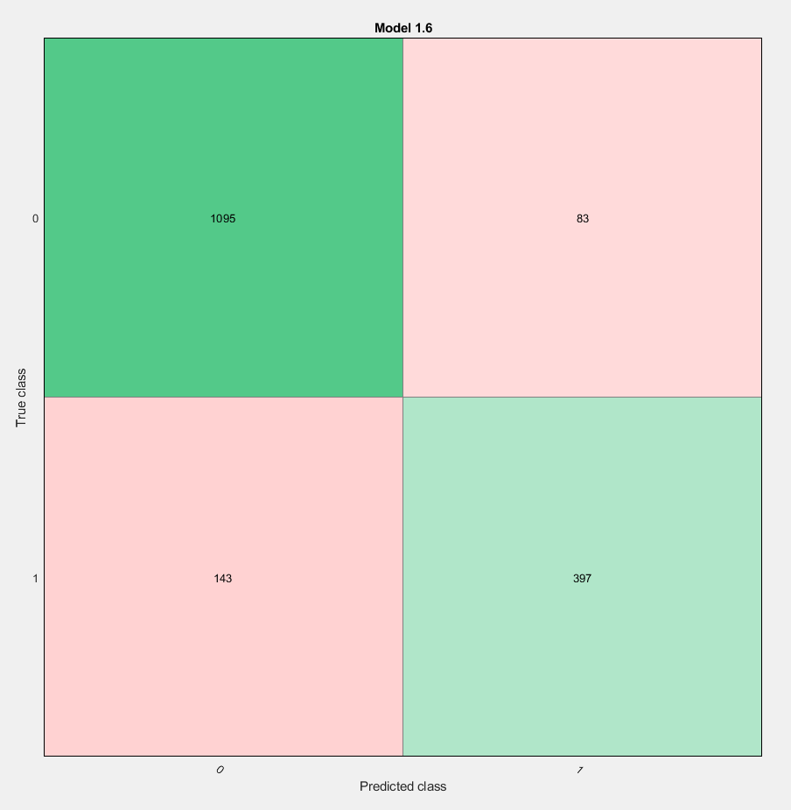
Logistic Regression
All 9 features
UnNormalized

Slide 36
Feature Selection - Normalized
Base accuracy = 89.9%
Removing Pedestrian Heading | Slightly increased accuracy (90.3%) using Ensemble; similar in other classifiers
Removing LaneID | Slightly increased accuracy using Ensemble; similar in other classifiers
Removing GazeAngle | Slightly increased accuracy using Ensemble; similar in other classifiers
Removing Pedestrian Wait Time | Slightly reduced accuracy using Ensemble; did not affect other classifiers (89.9%) than above
Removing DTCW | Slightly increased accuracy (90.9%) using Ensemble; similar in other classifiers
Removing DTCurb | No Change

Slide 37
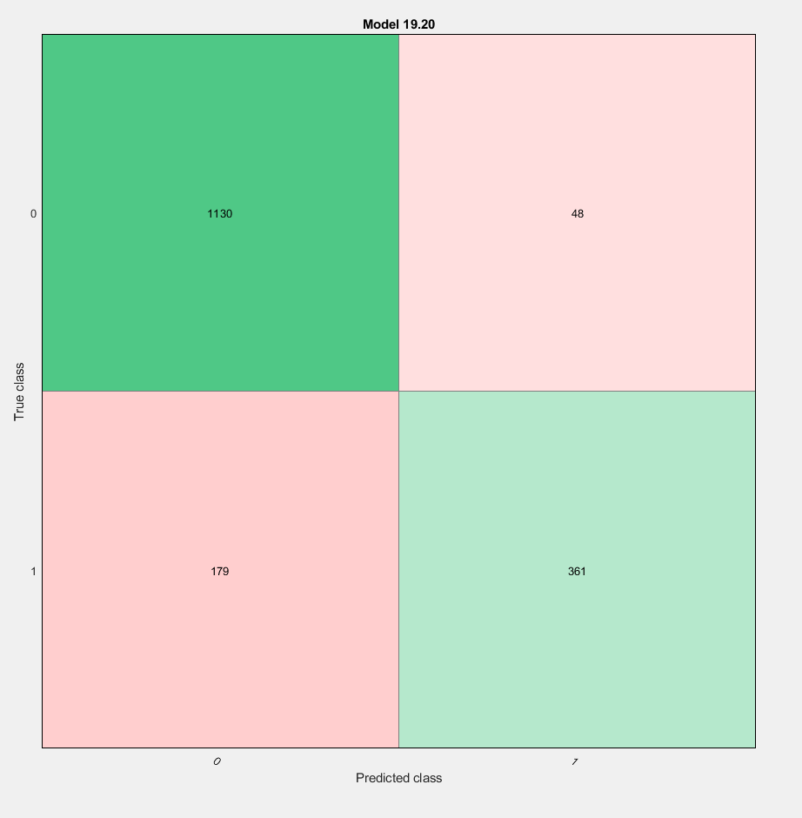
Feature Selection
Base accuracy = 89.9%
Removing Pedestrian average velocity | Slightly decreased accuracy (89%) using Ensemble; similar in other classifiers
Removing GazeRatio | No Change
Removing Gap duration | Decreased accuracy (87% max in Ensemble); more significant reduction in other classifiers
Removing Gap duration

Slide 38
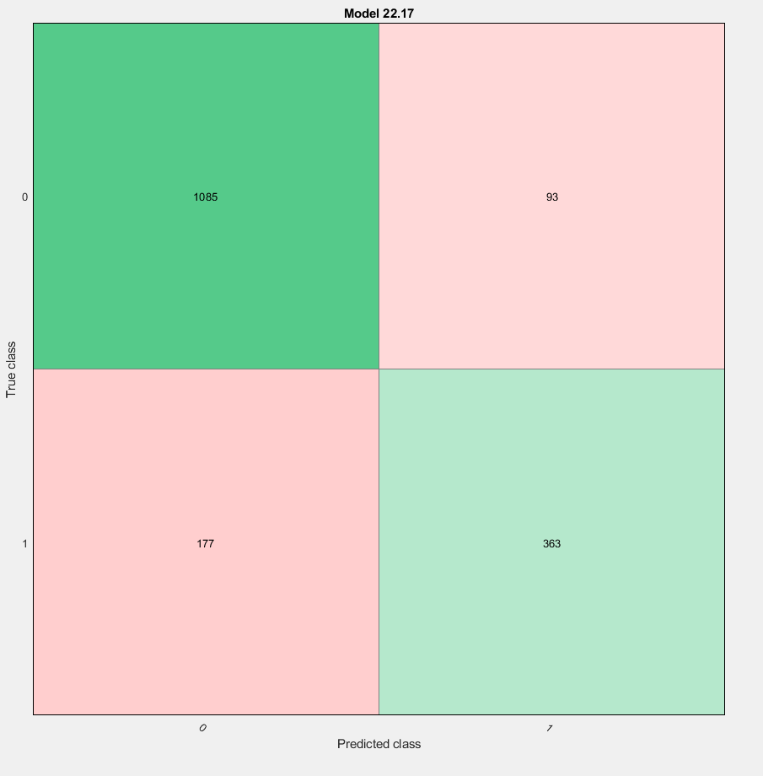
Ensemble
Only Gap duration
Normalized

Slide 39
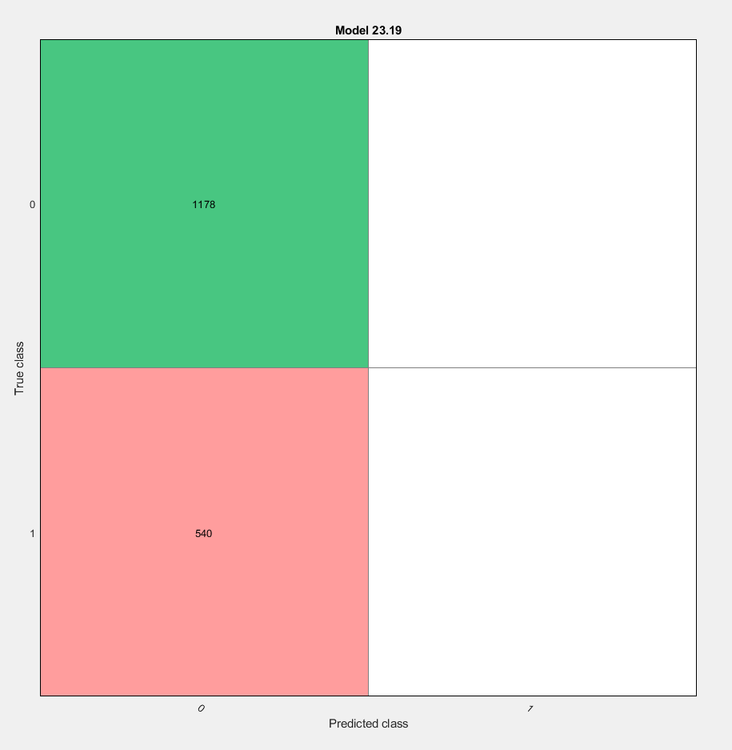
Ensemble
Only Gaze ratio
Normalized

Slide 40
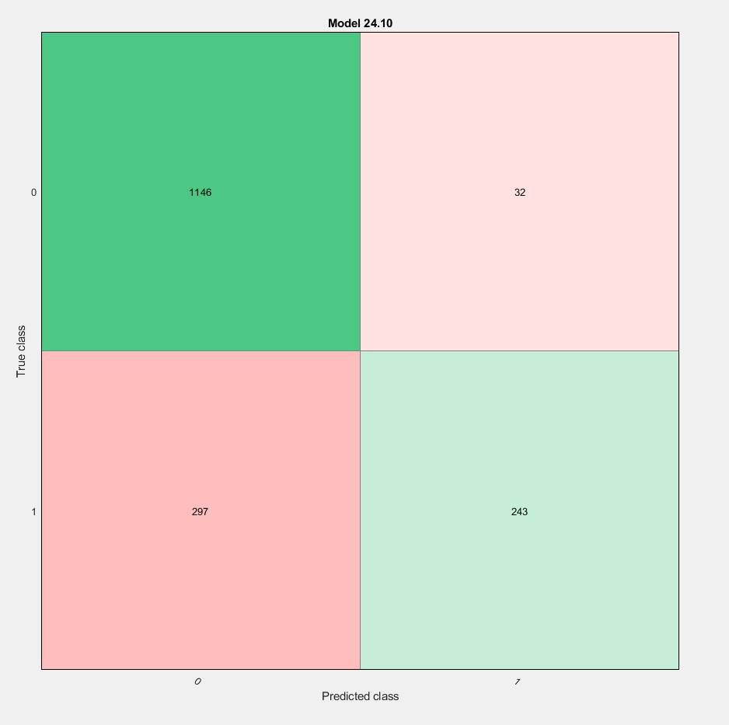
SVM – Fine Gaussian
Only Velocity (average)
Normalized

Slide 41
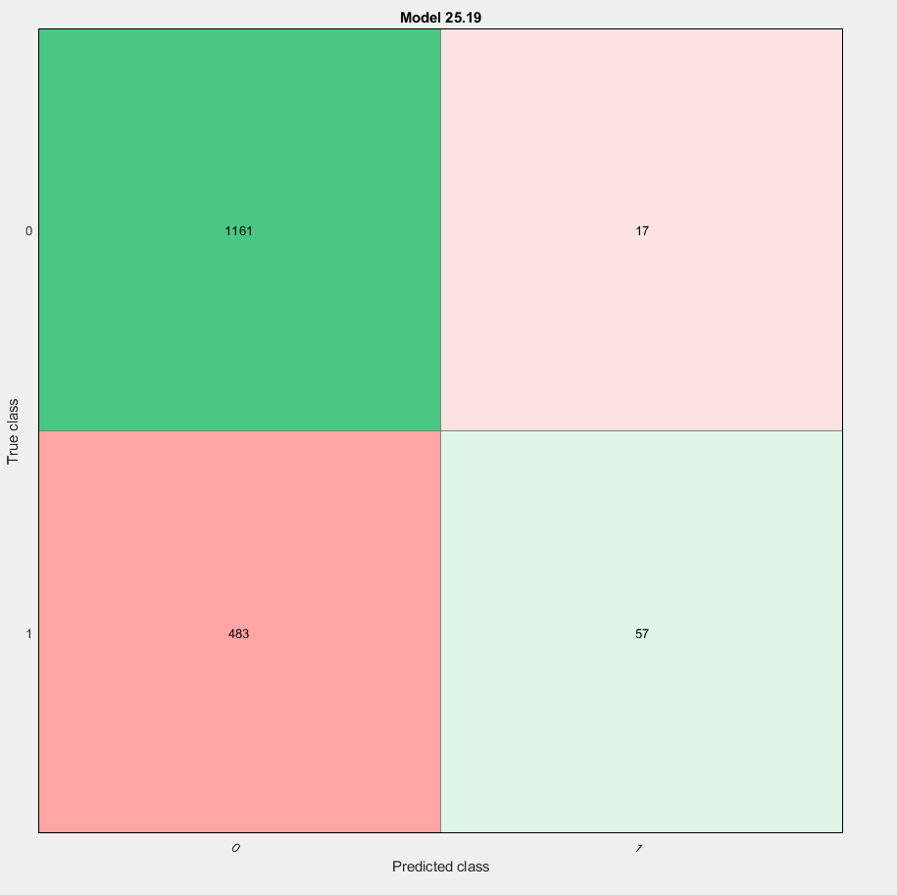
Ensemble
Only DTCurb
Normalized

Slide 42
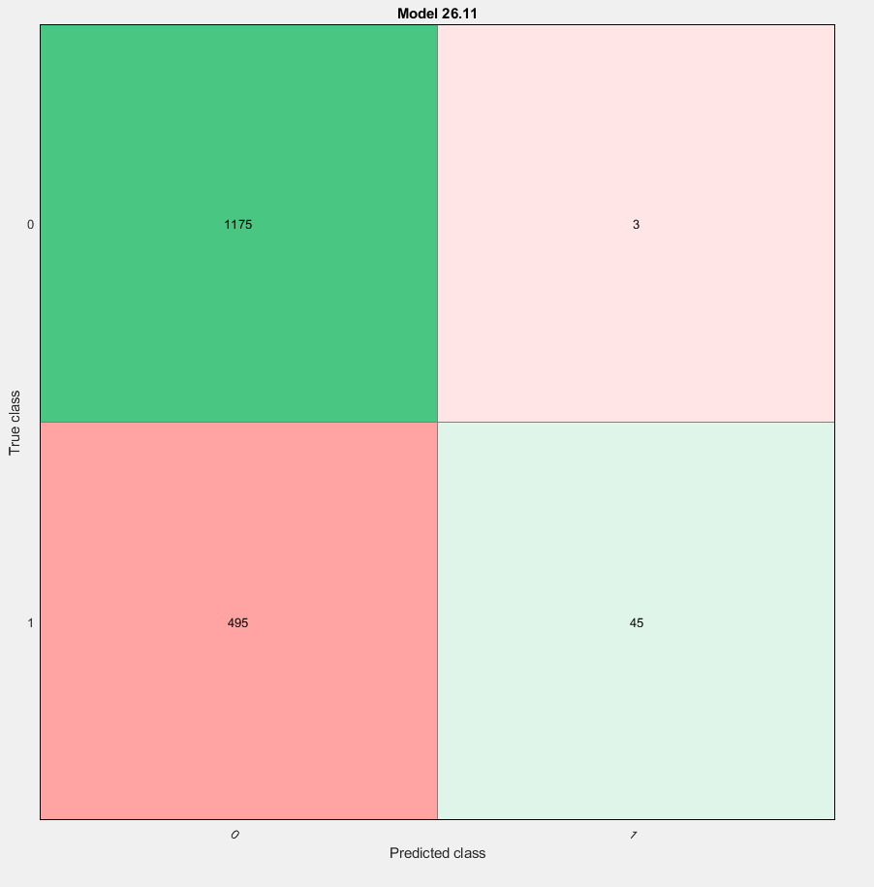
SVM
Only DTCW
Normalized

Slide 43
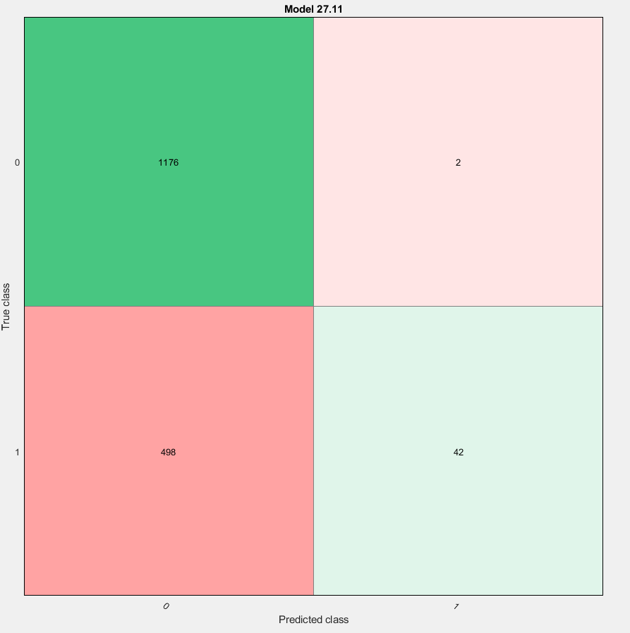
SVM
Only Wait Time
Normalized

Slide 44
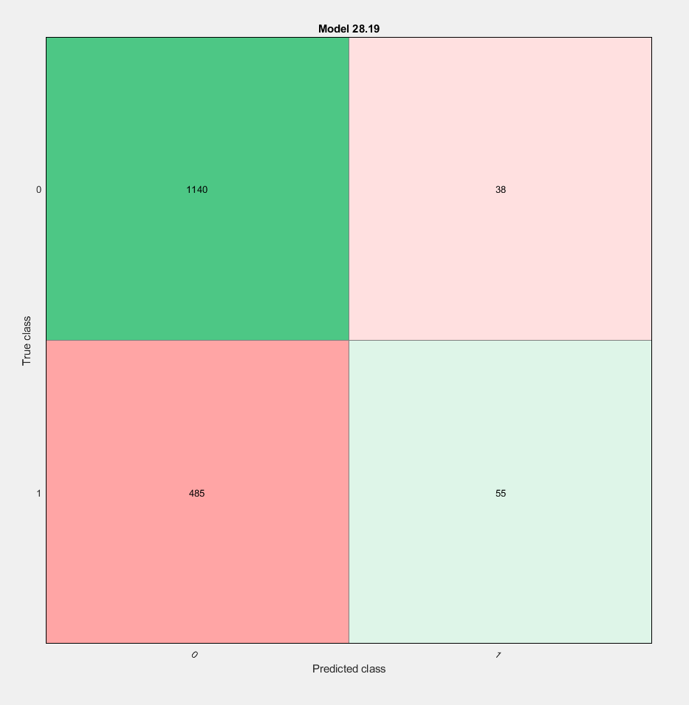
Ensemble
Only Gaze Angle
Normalized

Slide 45

Ensemble
Only Vehicle ID
Normalized

Slide 46
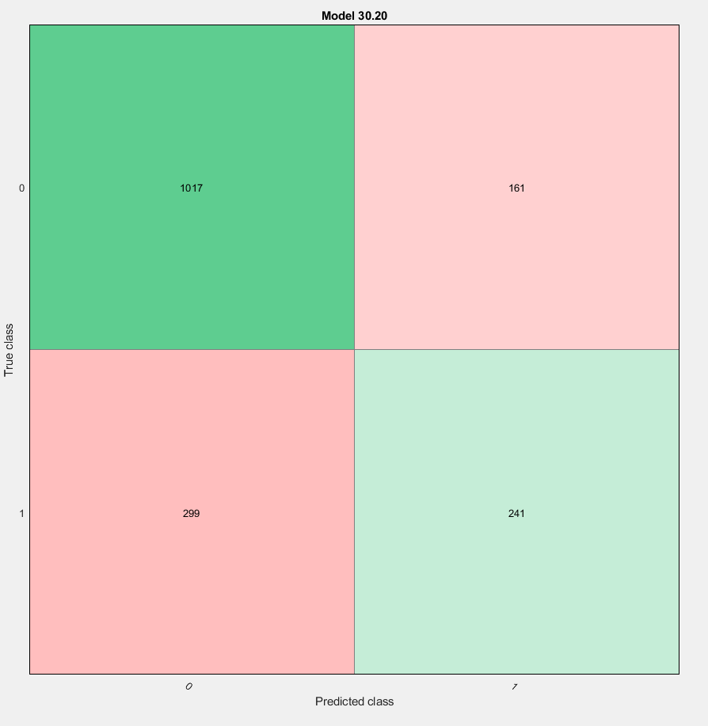
Ensemble
Only Pedestrian Heading
Normalized

Slide 47
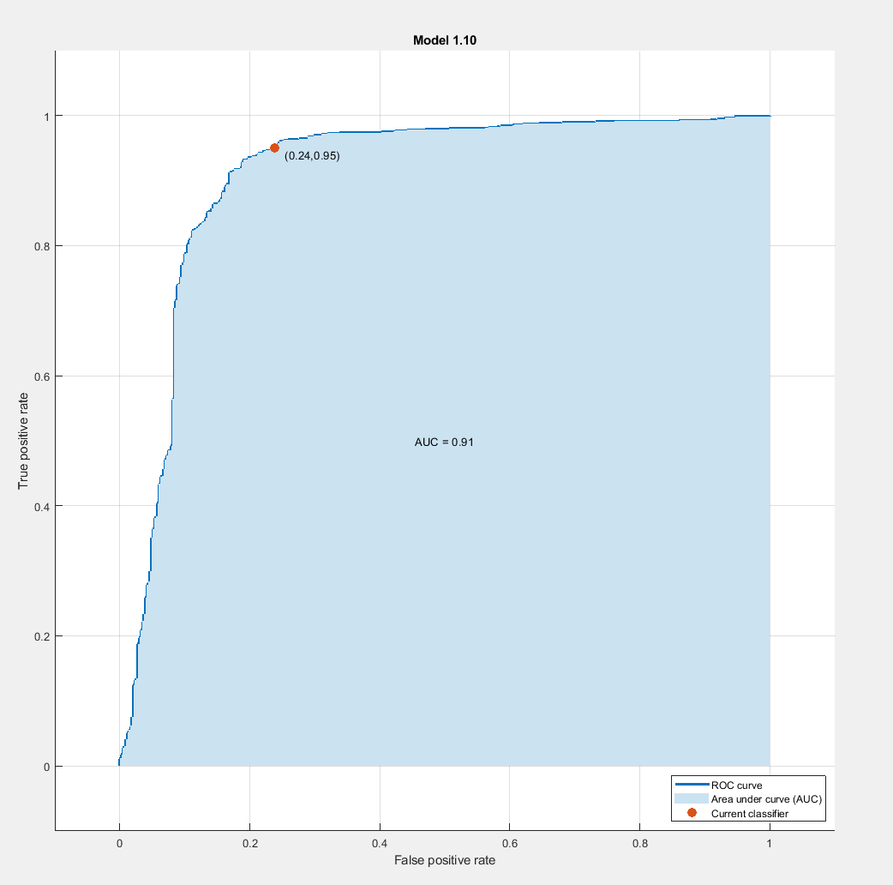
SVM – Fine Gaussian
Train Data
Gap duration
Average Ped Speed
DT Curb
DT CW
Cumulative Wait

Slide 48
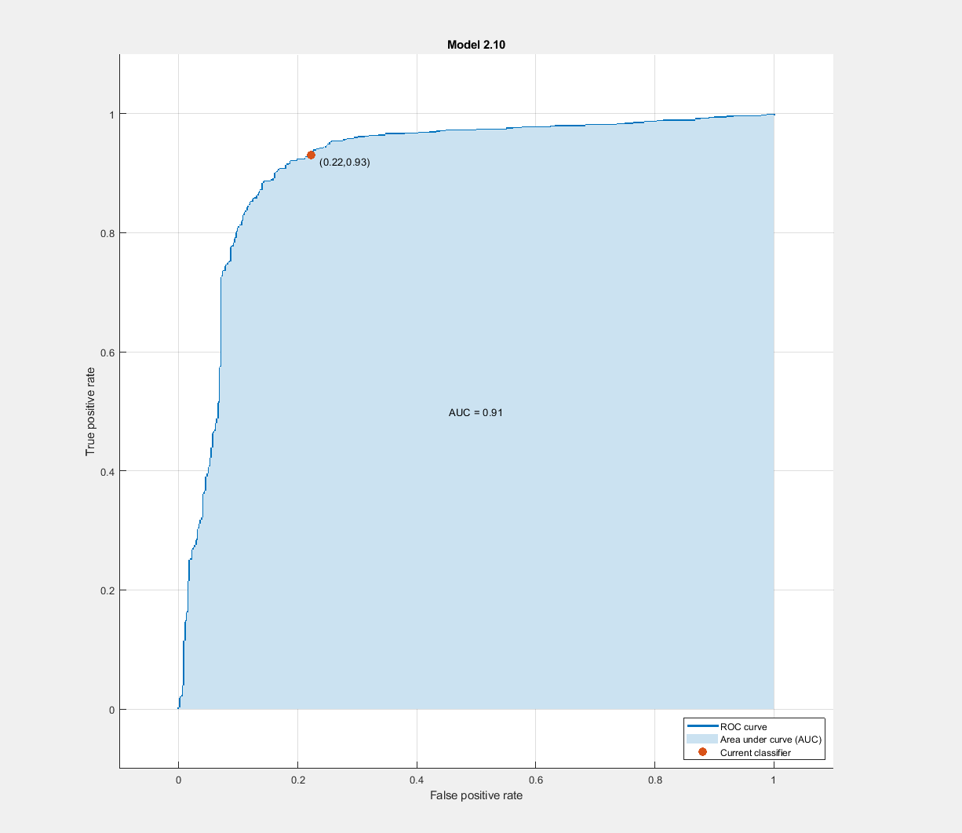
SVM – Fine Gaussian
Train Data
Gap duration
Average Ped Speed
DT Curb
DT CW

Slide 49
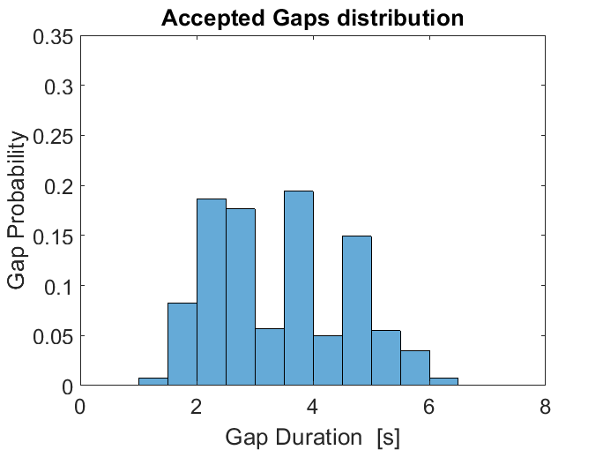
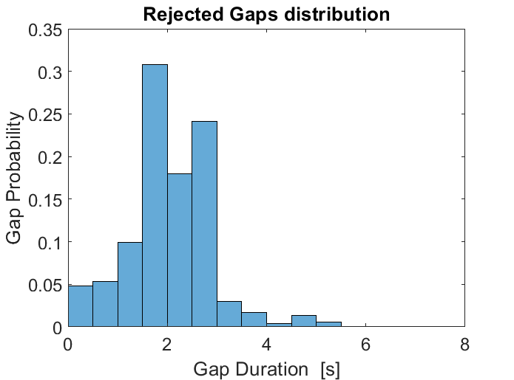
(a)
(b)

Slide 50
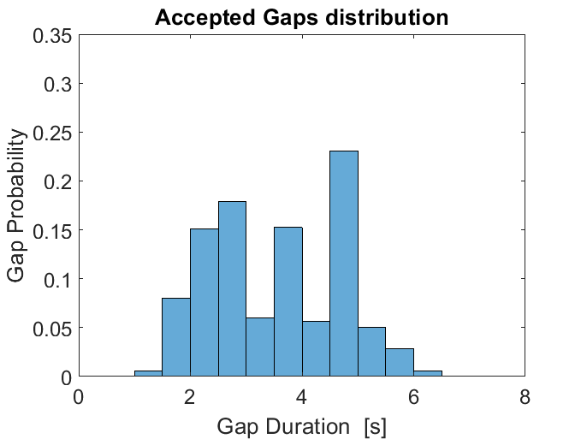

(a)
(b)

Slide 51
Behavior measures definitions
Waiting time [s]:
Time when pedestrian started waiting near the crosswalk till the time they started to walk that ended in them crossing the road.
Exact definition of waiting time not available in the literature I searched / used for comparison [1] [2].
Crossing speed [m/s] :
The average speed of pedestrians during crossing (i.e. start of cross till reaching the other side of the road)
start of cross
Start walking from wait that leads to a cross (wait to cross)
Reach the edge of the road (approach to cross)
Gap acceptance:
Traffic gap [s] is defined as the duration taken by the vehicle to reach the pedestrian.
In [3], traffic is calculated between two time points: (1) when pedestrian is about to step foot on the road and (2) when the car has crossed the vertical line of pedestrian path
[1] Hamed, M. M. (2001). Analysis of pedestrians’ behavior at pedestrian crossings. Safety science, 38(1), 63-82.
[2] X. Zhuang and C. Wu, “Pedestrians’ crossing behaviors and safety at unmarked roadway in China,” Accid. Anal. Prev., vol. 43, no. 6, pp. 1927–1936, 2011.
[3] G. Yannis, E. Papadimitriou, and A. Theofilatos, “Pedestrian gap acceptance for mid-block street crossing,” Transp. Plan. Technol., vol. 36, no. 5, pp. 450–462, 2013.

Slide 52
Behavior measures - descriptives
N = 540 crossings (30 subjects, 6 scenarios, 6 crossings)
Measure | Mean | Median | Maximum | Minimum
Waiting Time [s] | 8.95 | 2.1 | 161.1 | 0
Crossing speed [m/s] | 1.68 | 1.70 | 3.29 | 0.40
The very high difference between median and maximum values of the wait times shows that a disproportionately small number of people have high waiting times.

Slide 53


Behavior measures - histograms
N = 540 crossings (30 subjects, 6 scenarios, 6 crossings)
The very high difference between median and maximum values of the wait times shows that a disproportionately small number of people have high waiting times.

Slide 54
Waiting time outliers
Participants with high waiting times were discarded.
Outliers calculated from box plot and IQR
Mild outliers -> waiting time > 33.1 s
Extreme outliers -> waiting time > 52.2 s
N = 525 (no extreme outliers)
N = 505 (no mild outliers)

Slide 55
H-PED Model

Slide 56
Motivation
Multi-modality

Slide 57
Related Work

Slide 58
Research Questions

Slide 59
Methodology

Slide 60
Methodology

Slide 61

Results: Gap parameter Distribution
Total gaps = 2932
There are several high value (X 10⁵) and negative valued gaps, possibly because of small negative values of vehicle to pedestrian distance and small negative values of
Remove negative gaps, gaps with small vehicle velocity (0.5 m/s), N = 2805
Boxplot (Refer Figure)
Lower limit = 0
Upper limit = 10.78 s
Remove gaps greater than 10.78 s, N = 2655
Accepted Gaps = 480
Rejected Gaps = 2175

Slide 62
Results: Gap Distribution

Slide 63
Results: SVM Gap Acceptance
Features (n=9) | Description
F_cumwait | Cumulative wait time [s]
F_pedSpeed | Pedestrian speed in the last one second [m/s]
F_pedVehDist | Distance between pedestrian and vehicle [m]
F_DTCurb | Lateral distance between pedestrian and the curb [m]
F_DTCW | Longitudinal distance between pedestrian and CW [m]
F_Gaze | Proportion of time pedestrian looks at vehicle
F_VehSpeed | Instantaneous vehicle speed [m/s]
F_vehAcc | Instantaneous vehicle acceleration [m/s^2]
F_isSameDirection | (Boolean) Whether pedestrian facing the cars or walking in the same direction as the cars
A gap is accepted when pedestrian starts to cross
Jaywalking gaps are neglected.
Total gaps,
Accepted Gaps, n = 480
Rejected Gaps, n = 2185
80% training
Accepted Gaps, n = 386
Rejected Gaps, n = 1746

Slide 64
Results: SVM Gap Acceptance
Original, Accepted Gaps = 386, Rejected Gaps = 1746
Model Description | Type | Accuracy | Precision | Recall | F1-Score
All 9 features (CV) | SVM (Medium Gaussian) | 0.86 | 0.40 | 0.73 | 0.52
8 features: No ‘VehAcc’ (CV) | SVM (Medium Gaussian) | 0.86 | 0.35 | 0.77 | 0.48
7 features: No Acc, No direction (CV) | SVM (Medium Gaussian) | 0.86 | 0.36 | 0.76 | 0.49
CV - 10-fold Cross validation
TS – 20% test set

Slide 65
Results: SVM Gap Acceptance
BootStrap_1, Accepted Gaps = 2 X 386, Rejected Gaps = 1746
Model Description | Type | Accuracy | Precision | Recall | F1-Score
All 9 features (CV) | SVM (Fine Gaussian) | 0.92 | 0.83 | 0.90 | 0.86
8 features: No ‘VehAcc’ (CV) | SVM (Fine Gaussian) | 0.88 | 0.78 | 0.83 | 0.81
7 features: No Acc, No direction (CV) | SVM (Fine Gaussian) | 0.88 | 0.76 | 0.83 | 0.80
7 features: No Acc, No direction (TS) | SVM (Fine Gaussian) | 0.83 | 0.51 | 0.43 | 0.47
CV - 10-fold Cross validation
TS – 20% test set

Slide 66
Results: SVM Gap Acceptance
BootStrap_2, Accepted Gaps = 3 X 386, Rejected Gaps = 1746
Model Description | Type | Accuracy | Precision | Recall | F1-Score
All 9 features (CV) | SVM (Fine Gaussian) | 0.95 | 0.95 | 0.92 | 0.93
8 features: No ‘VehAcc’ (CV) | SVM (Fine Gaussian) | 0.91 | 0.92 | 0.87 | 0.89
7 features: No Acc, No direction (CV) | SVM (Fine Gaussian) | 0.91 | 0.91 | 0.88 | 0.89
7 features: No Acc, No direction (TS) | SVM (Fine Gaussian) | 0.81 | 0.45 | 0.45 | 0.45
CV - 10-fold Cross validation
TS – 20% test set

Slide 67
Results: SVM Gap Acceptance
BootStrap_2, Accepted Gaps = 3 X 386, Rejected Gaps = 1746
Cross-validation results
Removed Feature | Type | Accuracy | Precision | Recall | F1-Score
Veh-Ped distance | SVM (Fine Gaussian) | 0.83 | 0.74 | 0.82 | 0.78
DT Curb | SVM (Fine Gaussian) | 0.84 | 0.83 | 0.78 | 0.80
DT Crosswalk | SVM (Fine Gaussian) | 0.85 | 0.85 | 0.79 | 0.82
Vehicle Speed | SVM (Fine Gaussian) | 0.86 | 0.82 | 0.83 | 0.82
Pedestrian Speed | SVM (Fine Gaussian) | 0.87 | 0.85 | 0.83 | 0.84
Cumulative Wait | SVM (Fine Gaussian) | 0.90 | 0.90 | 0.87 | 0.88
Pedestrian Gaze | SVM (Fine Gaussian) | 0.91 | 0.90 | 0.87 | 0.88

Slide 68

Results: Gap parameter Distribution (Trial 2)
Total gaps = 2938
There are several high value (X 10⁵) and negative valued gaps, possibly because of small negative values of vehicle to pedestrian distance and small negative values of
Remove negative gaps, gaps with small vehicle velocity (0.5 m/s), N = 2812
Boxplot (Refer Figure)
Lower limit = 0
Upper limit = 10.84 s
Remove gaps greater than 10.78 s, N = 2658
Accepted Gaps = 480
Rejected Gaps = 2178

Slide 69
Results: SVM Gap Acceptance (Trial 2)
Features (n=9) | Description
F_cumwait | Cumulative wait time [s]
F_pedSpeed | Pedestrian speed in the last one second [m/s]
F_pedVehDist | Distance between pedestrian and vehicle [m]
F_DTCurb | Lateral distance between pedestrian and the curb [m]
F_DTCW | Longitudinal distance between pedestrian and CW [m]
F_Gaze | Proportion of time pedestrian looks at vehicle
F_VehSpeed | Instantaneous vehicle speed [m/s]
F_vehAcc | Instantaneous vehicle acceleration [m/s^2]
F_isSameDirection | (Boolean) Whether pedestrian facing the cars or walking in the same direction as the cars
F_isEgoNearLane | (Boolean) Whether the ego car is in the near lane or far lane
A gap is accepted when pedestrian starts to cross
Jaywalking gaps are neglected.
Accepted Gaps, n = 480
Rejected Gaps, n = 2178
80% training
Accepted Gaps, n = 386
Rejected Gaps, n = 1740

Slide 70
Results: SVM Gap Acceptance
Original, Accepted Gaps = 386, Rejected Gaps = 1740
Model Description | Type | Accuracy | Precision | Recall | F1-Score
All 10 features (CV) | SVM (Quadratic) | 0.86 | 0.43 | 0.67 | 0.52
9 features: No ‘VehAcc’ (CV) | SVM (Cubic) | 0.84 | 0.46 | 0.57 | 0.51
7 features: No Acc, No direction, No Lane (CV) | SVM (Cubic) | 0.85 | 0.39 | 0.62 | 0.48
CV - 5-fold Cross validation
TS – 20% test set

Slide 71
Results: SVM Gap Acceptance
BootStrap_1, Accepted Gaps = 2 X 386, Rejected Gaps = 1740
Model Description | Type | Accuracy | Precision | Recall | F1-Score
All 10 features (CV) | SVM (Fine Gaussian) | 0.91 | 0.81 | 0.88 | 0.84
9 features: No ‘VehAcc’ (CV) | SVM (Fine Gaussian) | 0.88 | 0.77 | 0.84 | 0.80
9 features: No Acc, No direction (TS) | SVM (Fine Gaussian) | 0.86 | 0.46 | 0.67 | 0.54
CV - 10-fold Cross validation
TS – 20% test set

Slide 72

Cross Intent parameter distribution
Total, N = 6009
w/ Intent, N = 4925
w/o intent, N = 1084

Slide 73

Cross Intent parameter distribution
Only pedestrians with crossing intent data

Slide 74

Cross Intent parameter distribution
Only pedestrians without crossing intent

Slide 75
Results: Cross Intent
Features (n=9) | Description
mean_pedSpeed | Pedestrian speed in the observation window [m/s]
mean_pedVehDist | Distance between pedestrian and vehicle [m]
mean_DTCurb | Lateral distance between pedestrian and the curb [m]
mean_DTCW | Longitudinal distance between pedestrian and CW [m]
Gaze | Proportion of time pedestrian looks at vehicle
mean_VehSpeed | Instantaneous vehicle speed [m/s]
mean_vehAcc | Instantaneous vehicle acceleration [m/s^2]
isSameDirection | (Boolean) Whether pedestrian facing the cars or walking in the same direction as the cars
Duration | Proportion of obs. Window for which there is an ego-vehicle
Jaywalking pedestrians are neglected.
80% training

Slide 76
Results: SVM Cross Intent
Original,
Model Description | Type | Accuracy | Precision (C/NC) | Recall (C/NC) | F1-Score (C/NC)
All 9 features (CV) | SVM (Medium Gaussian) | 0.85 | 0.95/0.36 | 0.87/0.62 | 0.91/0.45
8 features: No ‘VehAcc’ (CV) | SVM (Medium Gaussian) | 0.86 | 0.35 | 0.77 | 0.48
7 features: No Acc, No direction (CV) | SVM (Medium Gaussian) | 0.86 | 0.36 | 0.76 | 0.49
CV - 10-fold Cross validation
TS – 20% test set

Slide 77
Results: Cross Intent (Trial 2) w/o ego car
Features (n=9) | Description
mean_pedSpeed | Pedestrian speed in the observation window [m/s]
mean_DTCurb | Lateral distance between pedestrian and the curb [m]
mean_DTCW | Longitudinal distance between pedestrian and CW [m]
Jaywalking pedestrians are neglected
W/ Cross Intent, n = 12031
W/O Cross Intent, n = 2713
80% training
W/ Cross Intent, n = 9630
Rejected Gaps, n = 2165

Slide 78
Results: SVM Cross Intent
Original,
Model Description | Type | Accuracy | Precision (C/NC) | Recall (C/NC) | F1-Score (C/NC)
All 9 features (CV). No duration | SVM (Fine Gaussian) | 0.85 | 0.96/0.35 | 0.87/0.68 | 0.91/0.46
8 features: No ‘VehAcc’ (CV) | SVM (Medium Gaussian)
7 features: No Acc, No direction (CV) | SVM (Medium Gaussian)
CV - 5-fold Cross validation
TS – 20% test set

Slide 79
Results: SVM Cross Intent
BootStrapped X 1, Cross Intent = 9630, W/O Cross Intent = 2 X 2165
Model Description | Type | Accuracy | Precision (C/NC) | Recall (C/NC) | F1-Score (C/NC)
All 9 features (CV). No duration | SVM (Medium Gaussian) | 0.80 | 0.89/0.62 | 0.84/0.71 | 0.86/0.66
8 features: No ‘VehAcc’ (CV) | SVM (Fine Gaussian)
7 features: No Acc, No direction (CV) | SVM (Medium Gaussian)
CV - 5-fold Cross validation
TS – 20% test set

Slide 80
Results: Cross Intent (Trial 2) w/ ego car
Features (n=9) | Description
mean_pedSpeed | Pedestrian speed in the observation window [m/s]
mean_pedVehDist | Distance between pedestrian and vehicle [m]
mean_DTCurb | Lateral distance between pedestrian and the curb [m]
mean_DTCW | Longitudinal distance between pedestrian and CW [m]
Gaze | Proportion of time pedestrian looks at vehicle
mean_VehSpeed | Instantaneous vehicle speed [m/s]
mean_vehAcc | Instantaneous vehicle acceleration [m/s^2]
isSameDirection | (Boolean) Whether pedestrian facing the cars or walking in the same direction as the cars
Duration | Proportion of obs. Window for which there is an ego-vehicle
IsEgoNearLane | (Boolean) Whether the ego car is in the near lane or far lane
Jaywalking pedestrians are neglected
W/ Cross Intent, n = 18749
W/O Cross Intent, n = 3577
80% training
W/ Cross Intent, n = 15011
Rejected Gaps, n = 2850

Slide 81
Results: SVM Cross Intent
Original,
Model Description | Type | Accuracy | Precision (C/NC) | Recall (C/NC) | F1-Score (C/NC)
All 9 features (CV). No duration | SVM (Fine Gaussian) | 0.87 | 0.98/0.27 | 0.88/0.76 | 0.93/0.40
8 features: No ‘VehAcc’ (CV) | SVM (Medium Gaussian)
7 features: No Acc, No direction (CV) | SVM (Medium Gaussian)
CV - 5-fold Cross validation
TS – 20% test set

Slide 82
Results: SVM Cross Intent
Boot strapped twice
Model Description | Type | Accuracy | Precision (C/NC) | Recall (C/NC) | F1-Score (C/NC)
All 9 features (CV). No duration | SVM (Medium Gaussian) | 0.81 | 0.80/0.84 | 0.90/0.71 | 0.85/0.77
All 9 features (CV). No duration | SVM (Fine Gaussian) | 0.94 | 0.94/0.94 | 0.97/0.91 | 0.96/0.92
7 features: No Acc, No direction (CV) | SVM (Medium Gaussian)
CV - 5-fold Cross validation
TS – 20% test set

